Slide 1
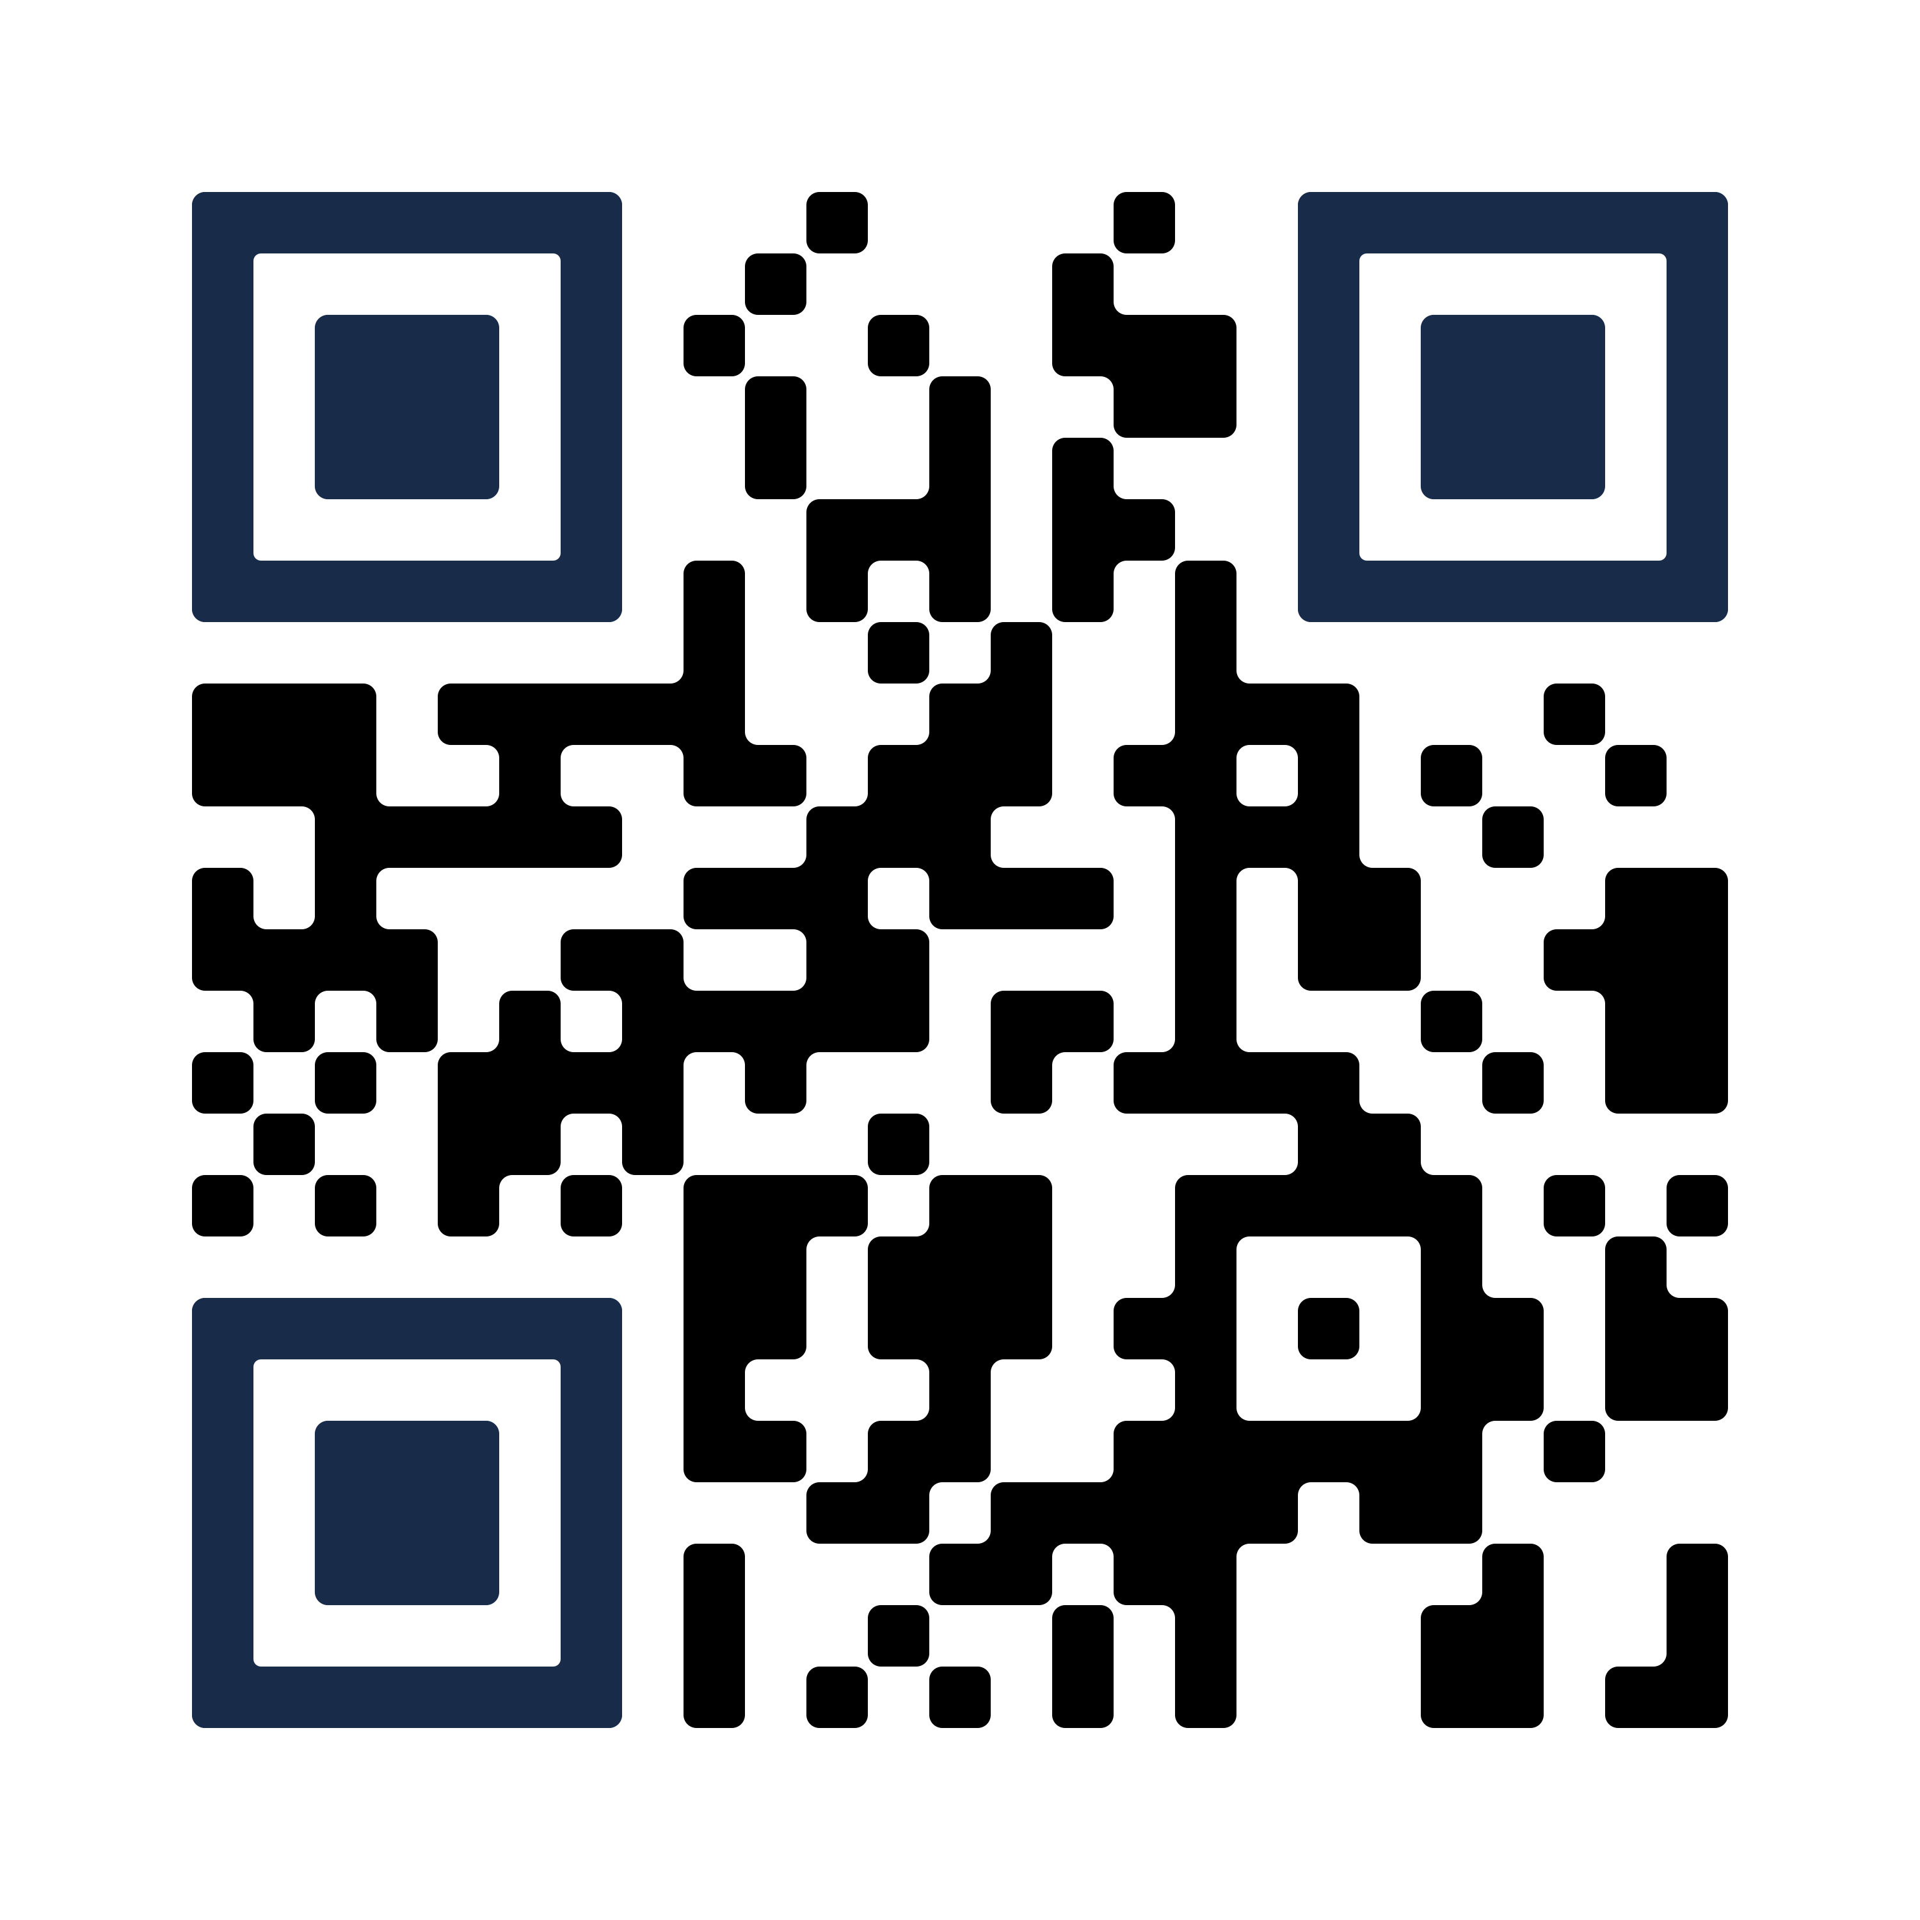

CalFresh: Food Support
If you're skipping or stretching meals, or having difficulties accessing food, visit the Basic Needs Center. They can connect you to food resources – including CalFresh.
CalFresh, California’s Supplemental Nutrition Assistance Program, can provide up to $292 a month for groceries. CalFresh application and recertification help is available to students!
Scan the QR Code to apply for CalFresh or visit basicneeds.ucsd.edu and follow their Instagram @ucsdbasicneeds to discover other food and support resources.
Have trouble applying to CalFresh?
Visit the Hub Basic Needs Center website for more assistance and to re-apply

